Slide 1
Chapter 5: Memory Management (Main Memory)

Slide 2
Chapter 5: Memory Management
Background
Contiguous Memory Allocation
Paging
Structure of the Page Table
Swapping

Slide 3
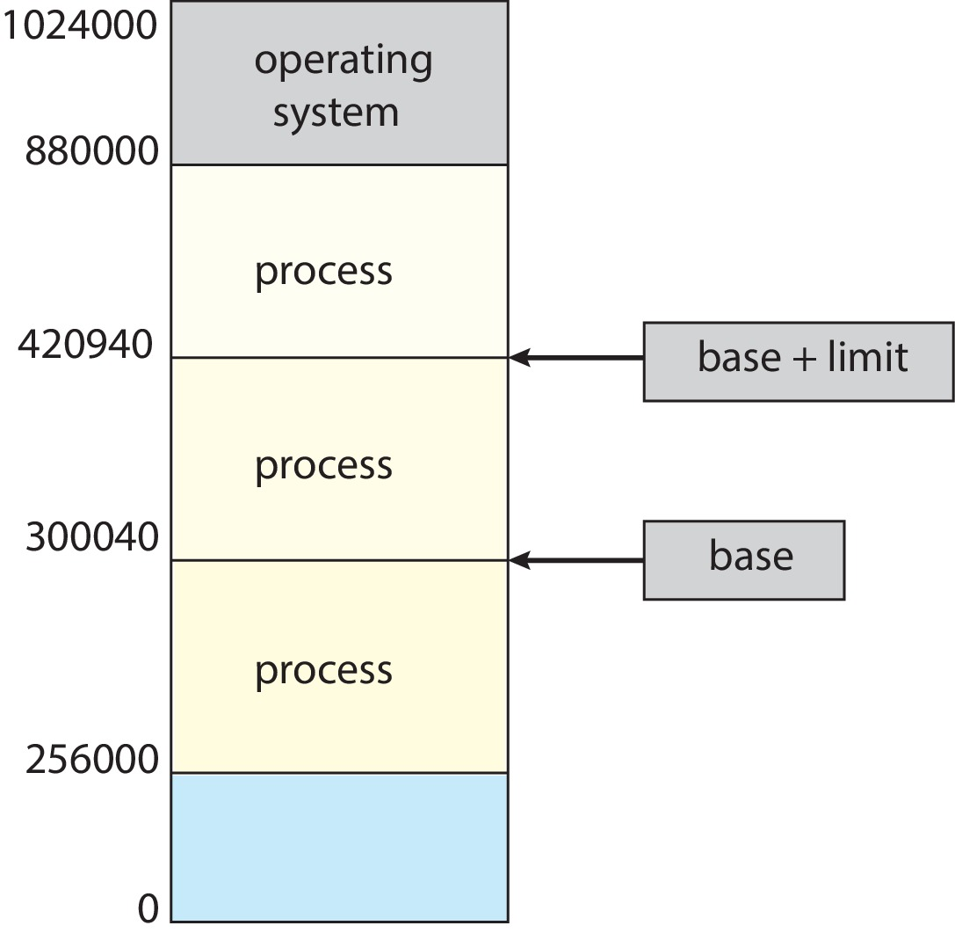
Protection
Need to ensure that a process can access only those addresses in its address space.
We can provide this protection by using a pair of base and limit registers define the logical address space of a process

Slide 4
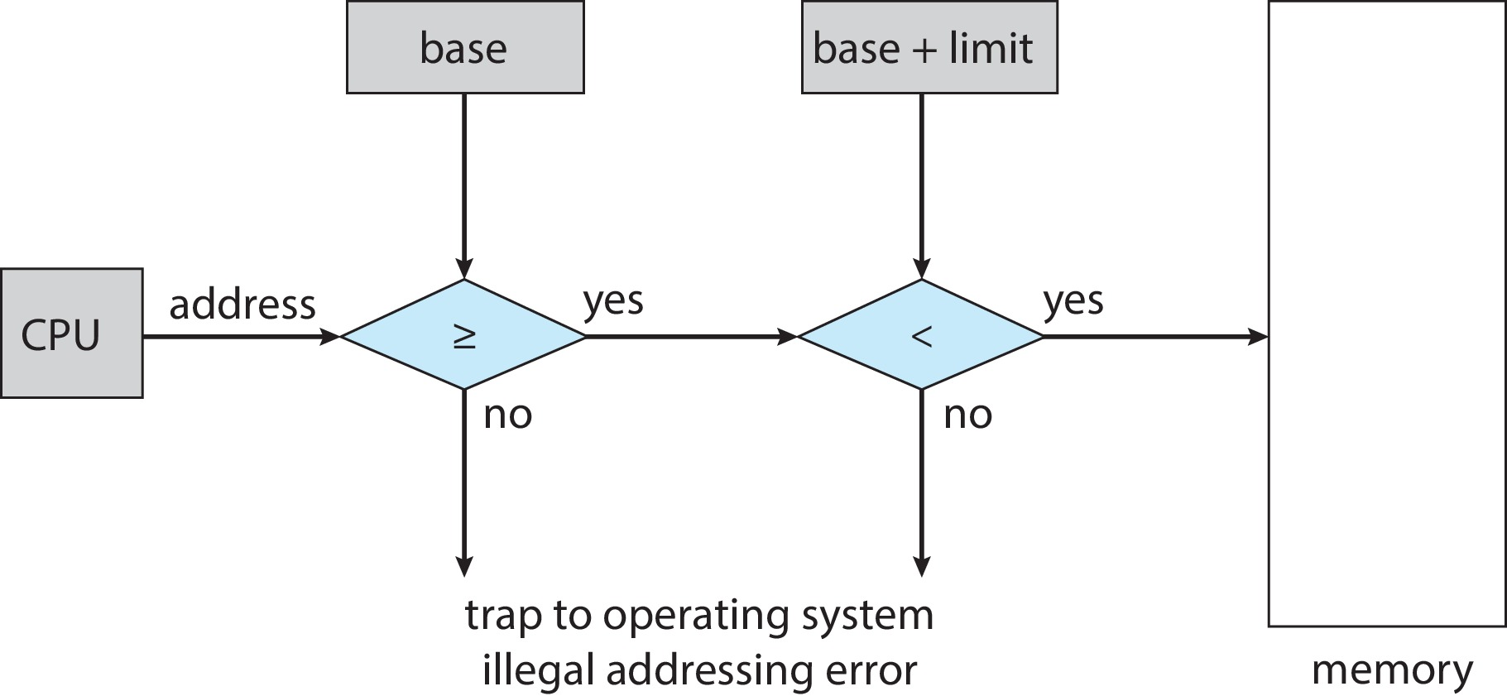
Hardware Address Protection
CPU must check every memory access generated in user mode to be sure it is between base and limit for that user
the instructions to loading the base and limit registers are privileged

Slide 5
Address Binding
Programs on disk, ready to be brought into memory to execute form an input queue
Without support, must be loaded into address 0000
Inconvenient to have first user process physical address always at 0000
How can it not be?
Addresses represented in different ways at different stages of a program’s life
Source code addresses usually symbolic
Compiled code addresses bind to relocatable addresses
i.e., “14 bytes from beginning of this module”
Linker or loader will bind relocatable addresses to absolute addresses
i.e., 74014
Each binding maps one address space to another

Slide 6
Binding of Instructions and Data to Memory
Address binding of instructions and data to memory addresses can happen at three different stages
Compile time: If memory location known a priori, absolute code can be generated; must recompile code if starting location changes
Load time: Must generate relocatable code if memory location is not known at compile time
Execution time: Binding delayed until run time if the process can be moved during its execution from one memory segment to another
Need hardware support for address maps (e.g., base and limit registers)

Slide 7
Logical vs. Physical Address Space
The concept of a logical address space that is bound to a separate physical address space is central to proper memory management
Logical address – generated by the CPU; also referred to as virtual address
Physical address – address seen by the memory unit
Logical and physical addresses are the same in compile-time and load-time address-binding schemes; logical (virtual) and physical addresses differ in execution-time address-binding scheme
Logical address space is the set of all logical addresses generated by a program
Physical address space is the set of all physical addresses generated by a program

Slide 8
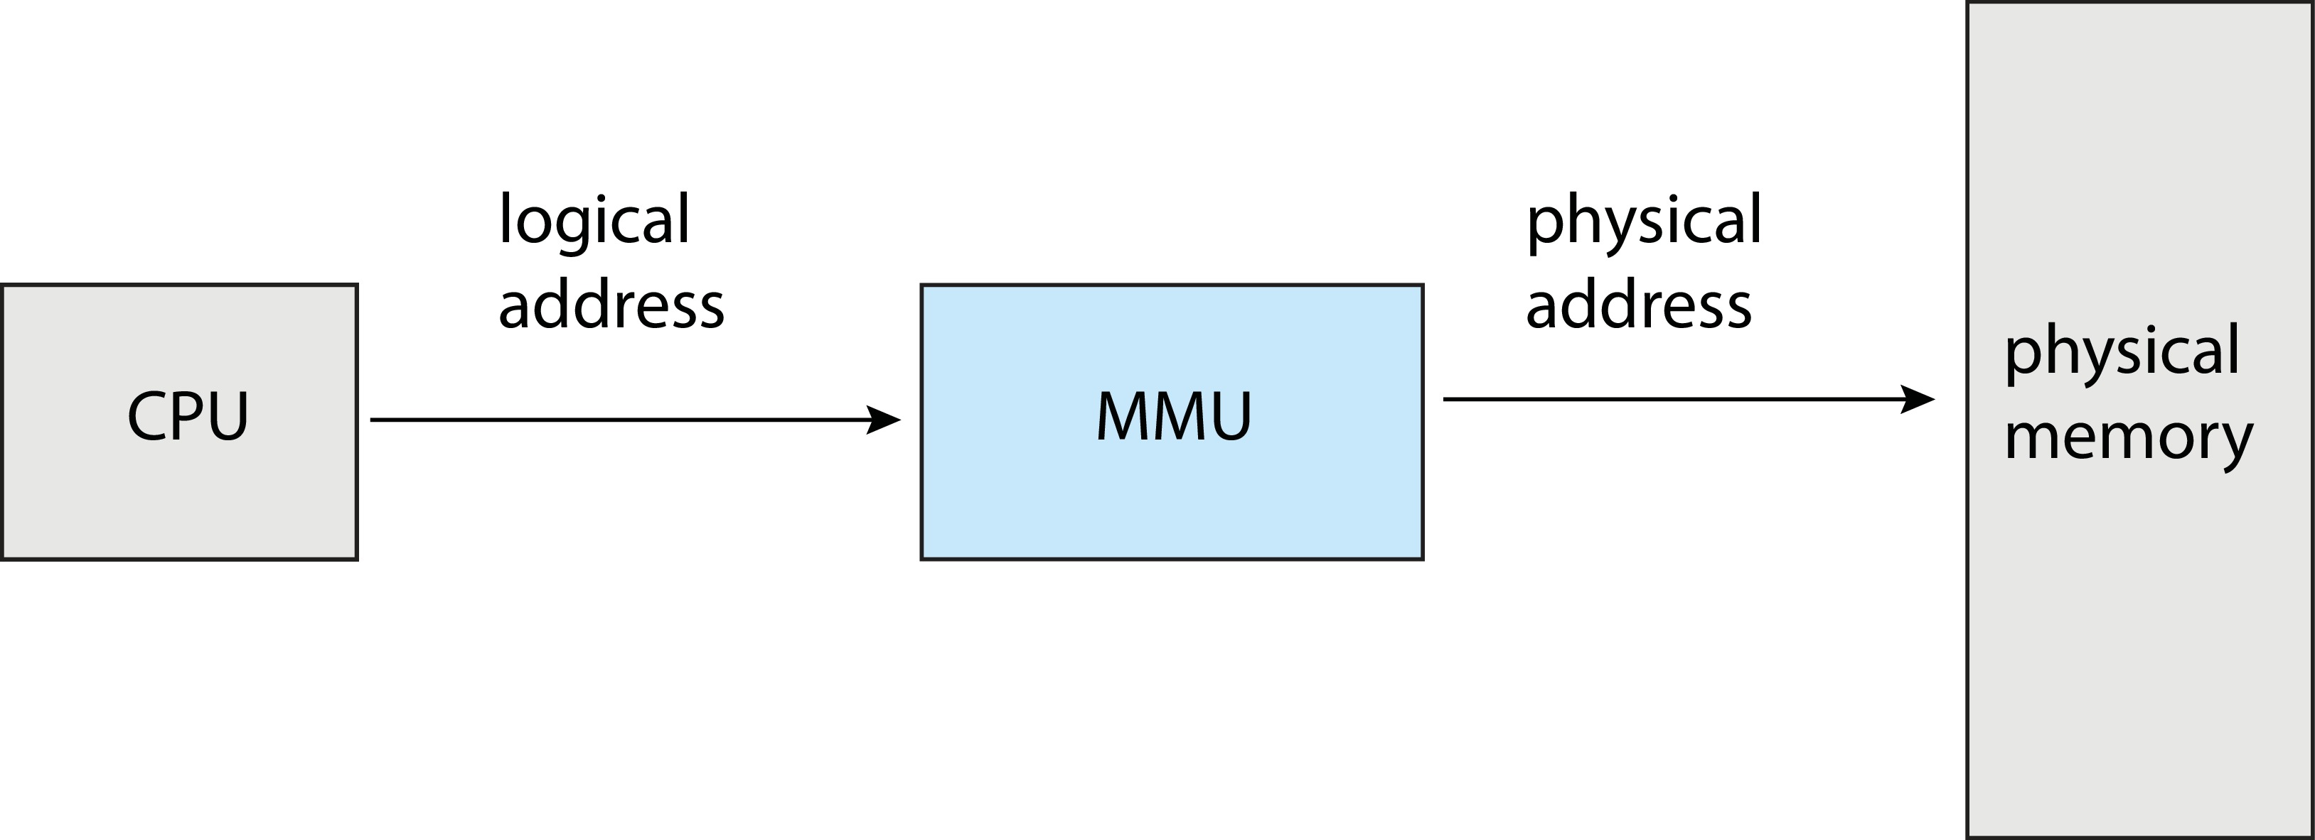
Memory-Management Unit (MMU)
Hardware device that at run time maps virtual to physical address
Many methods possible, covered in the rest of this chapter

Slide 9
Memory-Management Unit (Cont.) (Self Study)
Consider simple scheme. which is a generalization of the base-register scheme.
The base register now called relocation register
The value in the relocation register is added to every address generated by a user process at the time it is sent to memory
The user program deals with logical addresses; it never sees the real physical addresses
Execution-time binding occurs when reference is made to location in memory
Logical address bound to physical addresses

Slide 10
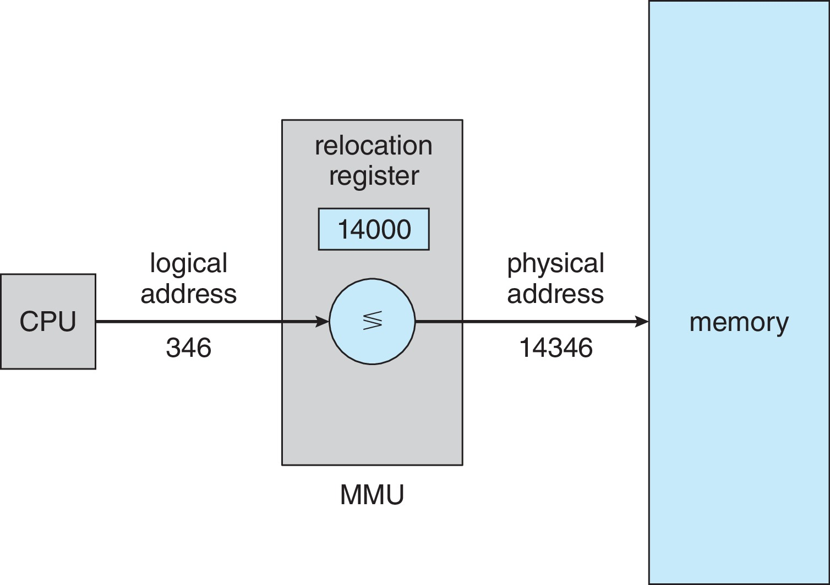
Memory-Management Unit (Cont.)
Consider simple scheme. which is a generalization of the base-register scheme.
The base register now called relocation register
The value in the relocation register is added to every address generated by a user process at the time it is sent to memory

Slide 11
Dynamic Loading
The entire program does need to be in memory to execute
Routine is not loaded until it is called
Better memory-space utilization; unused routine is never loaded
All routines kept on disk in relocatable load format
Useful when large amounts of code are needed to handle infrequently occurring cases
No special support from the operating system is required
Implemented through program design
OS can help by providing libraries to implement dynamic loading

Slide 12
Dynamic Linking
Static linking – system libraries and program code combined by the loader into the binary program image
Dynamic linking –linking postponed until execution time
Small piece of code, stub, used to locate the appropriate memory-resident library routine
Stub replaces itself with the address of the routine, and executes the routine
Operating system checks if routine is in processes’ memory address
If not in address space, add to address space
Dynamic linking is particularly useful for libraries
System also known as shared libraries
Consider applicability to patching system libraries
Versioning may be needed

Slide 13
Contiguous Allocation (Self Study)
Main memory must support both OS and user processes
Limited resource, must allocate efficiently
Contiguous allocation is one early method
Main memory usually into two partitions:
Resident operating system, usually held in low memory with interrupt vector
User processes then held in high memory
Each process contained in single contiguous section of memory

Slide 14
Contiguous Allocation (Cont.) (Self Study)
Relocation registers used to protect user processes from each other, and from changing operating-system code and data
Base register contains value of smallest physical address
Limit register contains range of logical addresses – each logical address must be less than the limit register
MMU maps logical address dynamically
Can then allow actions such as kernel code being transient and kernel changing size

Slide 15
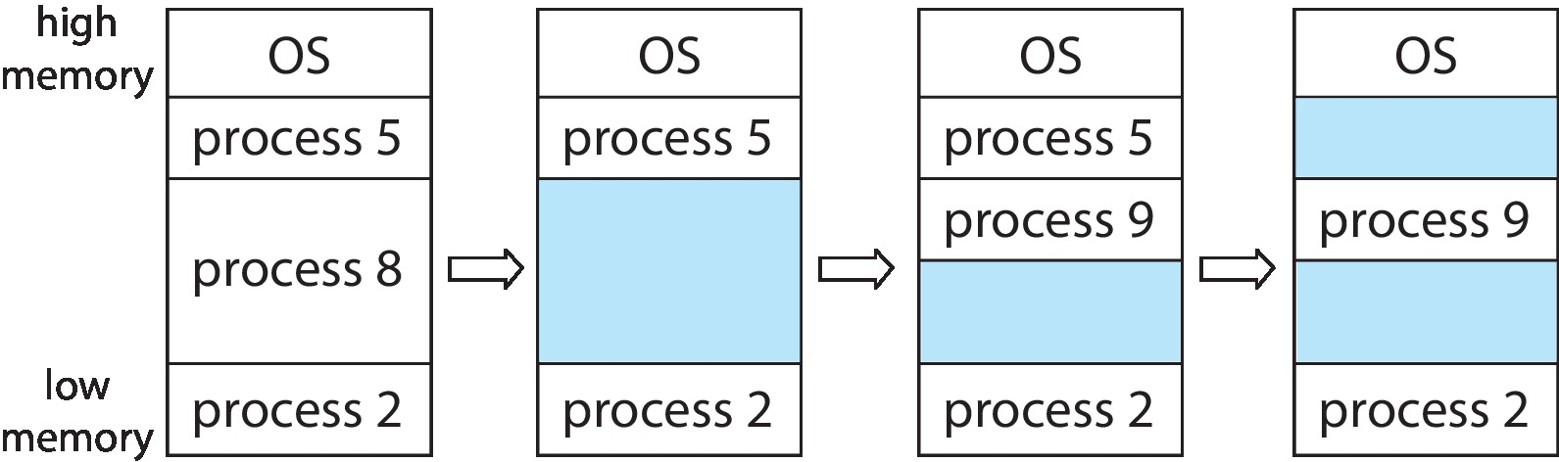
Variable Partition
Multiple-partition allocation
Degree of multiprogramming limited by number of partitions
Variable-partition sizes for efficiency (sized to a given process’ needs)
Hole – block of available memory; holes of various size are scattered throughout memory
When a process arrives, it is allocated memory from a hole large enough to accommodate it
Process exiting frees its partition, adjacent free partitions combined
Operating system maintains information about: a) allocated partitions b) free partitions (hole)

Slide 16
Dynamic Storage-Allocation Problem
How to satisfy a request of size n from a list of free holes?
First-fit: Allocate the first hole that is big enough
Best-fit: Allocate the smallest hole that is big enough; must search entire list, unless ordered by size
Produces the smallest leftover hole
Worst-fit: Allocate the largest hole; must also search entire list
Produces the largest leftover hole
First-fit and best-fit better than worst-fit in terms of speed and storage utilization

Slide 17
Fragmentation
External Fragmentation – total memory space exists to satisfy a request, but it is not contiguous
Internal Fragmentation – allocated memory may be slightly larger than requested memory; this size difference is memory internal to a partition, but not being used
First fit analysis reveals that given N blocks allocated, 0.5 N blocks lost to fragmentation
1/3 may be unusable -> 50-percent rule

Slide 18
Fragmentation (Cont.) (Self Study)
Reduce external fragmentation by compaction
Shuffle memory contents to place all free memory together in one large block
Compaction is possible only if relocation is dynamic, and is done at execution time
I/O problem
Latch job in memory while it is involved in I/O
Do I/O only into OS buffers
Now consider that backing store has same fragmentation problems

Slide 19
Paging
Physical address space of a process can be noncontiguous; process is allocated physical memory whenever the latter is available
Avoids external fragmentation
Avoids problem of varying sized memory chunks
Divide physical memory into fixed-sized blocks called frames
Size is power of 2, between 512 bytes and 16 Mbytes
Divide logical memory into blocks of same size called pages
Keep track of all free frames
To run a program of size N pages, need to find N free frames and load program
Set up a page table to translate logical to physical addresses
Backing store likewise split into pages
Still have Internal fragmentation

Slide 20
Address Translation Scheme
Address generated by CPU is divided into:
Page number (p) – used as an index into a page table which contains base address of each page in physical memory
Page offset (d) – combined with base address to define the physical memory address that is sent to the memory unit
For given logical address space 2^{m} and page size 2^{n}

Slide 21
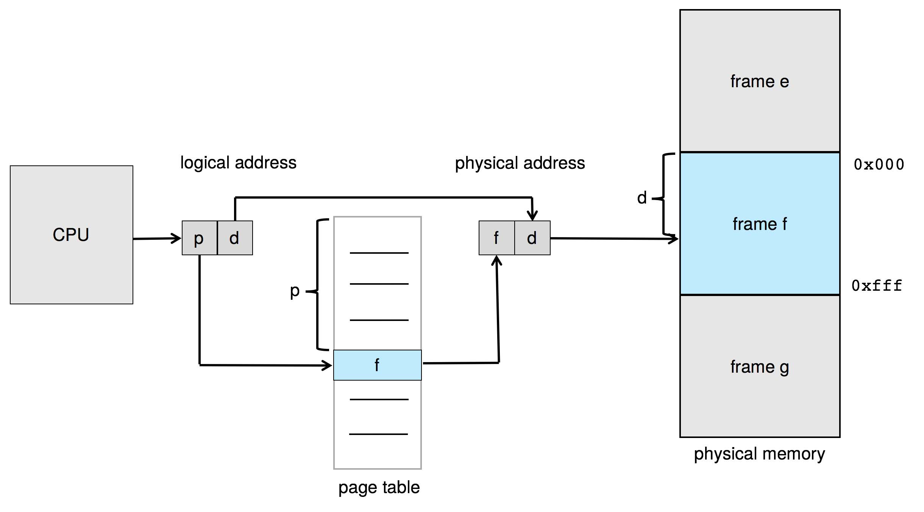
Paging Hardware (Self Study)

Slide 22

Paging Model of Logical and Physical Memory

Slide 23

Paging Example (Self Study)
Logical address: n = 2 and m = 4. Using a page size of 4 bytes and a physical memory of 32 bytes (8 pages)

Slide 24
Paging -- Calculating internal fragmentation (Self Study)
Page size = 2,048 bytes
Process size = 72,766 bytes
35 pages + 1,086 bytes
Internal fragmentation of 2,048 - 1,086 = 962 bytes
Worst case fragmentation = 1 frame – 1 byte
On average fragmentation = 1 / 2 frame size
So small frame sizes desirable?
But each page table entry takes memory to track
Page sizes growing over time
Solaris supports two page sizes – 8 KB and 4 MB

Slide 25

Free Frames (Self Study)
Before allocation
After allocation

Slide 26
Implementation of Page Table (Self Study)
Page table is kept in main memory
Page-table base register (PTBR) points to the page table
Page-table length register (PTLR) indicates size of the page table
In this scheme every data/instruction access requires two memory accesses
One for the page table and one for the data / instruction
The two-memory access problem can be solved by the use of a special fast-lookup hardware cache called translation look-aside buffers (TLBs) (also called associative memory).

Slide 27
Translation Look-Aside Buffer (Self Study)
Some TLBs store address-space identifiers (ASIDs) in each TLB entry – uniquely identifies each process to provide address-space protection for that process
Otherwise need to flush at every context switch
TLBs typically small (64 to 1,024 entries)
On a TLB miss, value is loaded into the TLB for faster access next time
Replacement policies must be considered
Some entries can be wired down for permanent fast access

Slide 28
Memory Protection (Self Study)
Memory protection implemented by associating protection bit with each frame to indicate if read-only or read-write access is allowed
Can also add more bits to indicate page execute-only, and so on
Valid-invalid bit attached to each entry in the page table:
“valid” indicates that the associated page is in the process’ logical address space, and is thus a legal page
“invalid” indicates that the page is not in the process’ logical address space
Or use page-table length register (PTLR)
Any violations result in a trap to the kernel

Slide 29

Valid (v) or Invalid (i) Bit In A Page Table

Slide 30
Swapping
A process can be swapped temporarily out of memory to a backing store, and then brought back into memory for continued execution
Total physical memory space of processes can exceed physical memory
Backing store – fast disk large enough to accommodate copies of all memory images for all users; must provide direct access to these memory images
Roll out, roll in – swapping variant used for priority-based scheduling algorithms; lower-priority process is swapped out so higher-priority process can be loaded and executed
Major part of swap time is transfer time; total transfer time is directly proportional to the amount of memory swapped
System maintains a ready queue of ready-to-run processes which have memory images on disk

Slide 31

Schematic View of Swapping

Slide 32
Chapter 5 (Cont’d): Virtual Memory

Slide 33
Chapter 5 (Cont’d): Virtual Memory
Background
Demand Paging
Copy-on-Write
Page Replacement
Allocation of Frames
Thrashing

Slide 34
Virtual memory
Virtual memory – separation of user logical memory from physical memory
Only part of the program needs to be in memory for execution
Logical address space can therefore be much larger than physical address space
Allows address spaces to be shared by several processes
Allows for more efficient process creation
More programs running concurrently
Less I/O needed to load or swap processes

Slide 35
Virtual memory (Cont.)
Virtual address space – logical view of how process is stored in memory
Usually start at address 0, contiguous addresses until end of space
Meanwhile, physical memory organized in page frames
MMU must map logical to physical
Virtual memory can be implemented via:
Demand paging
Demand segmentation

Slide 36
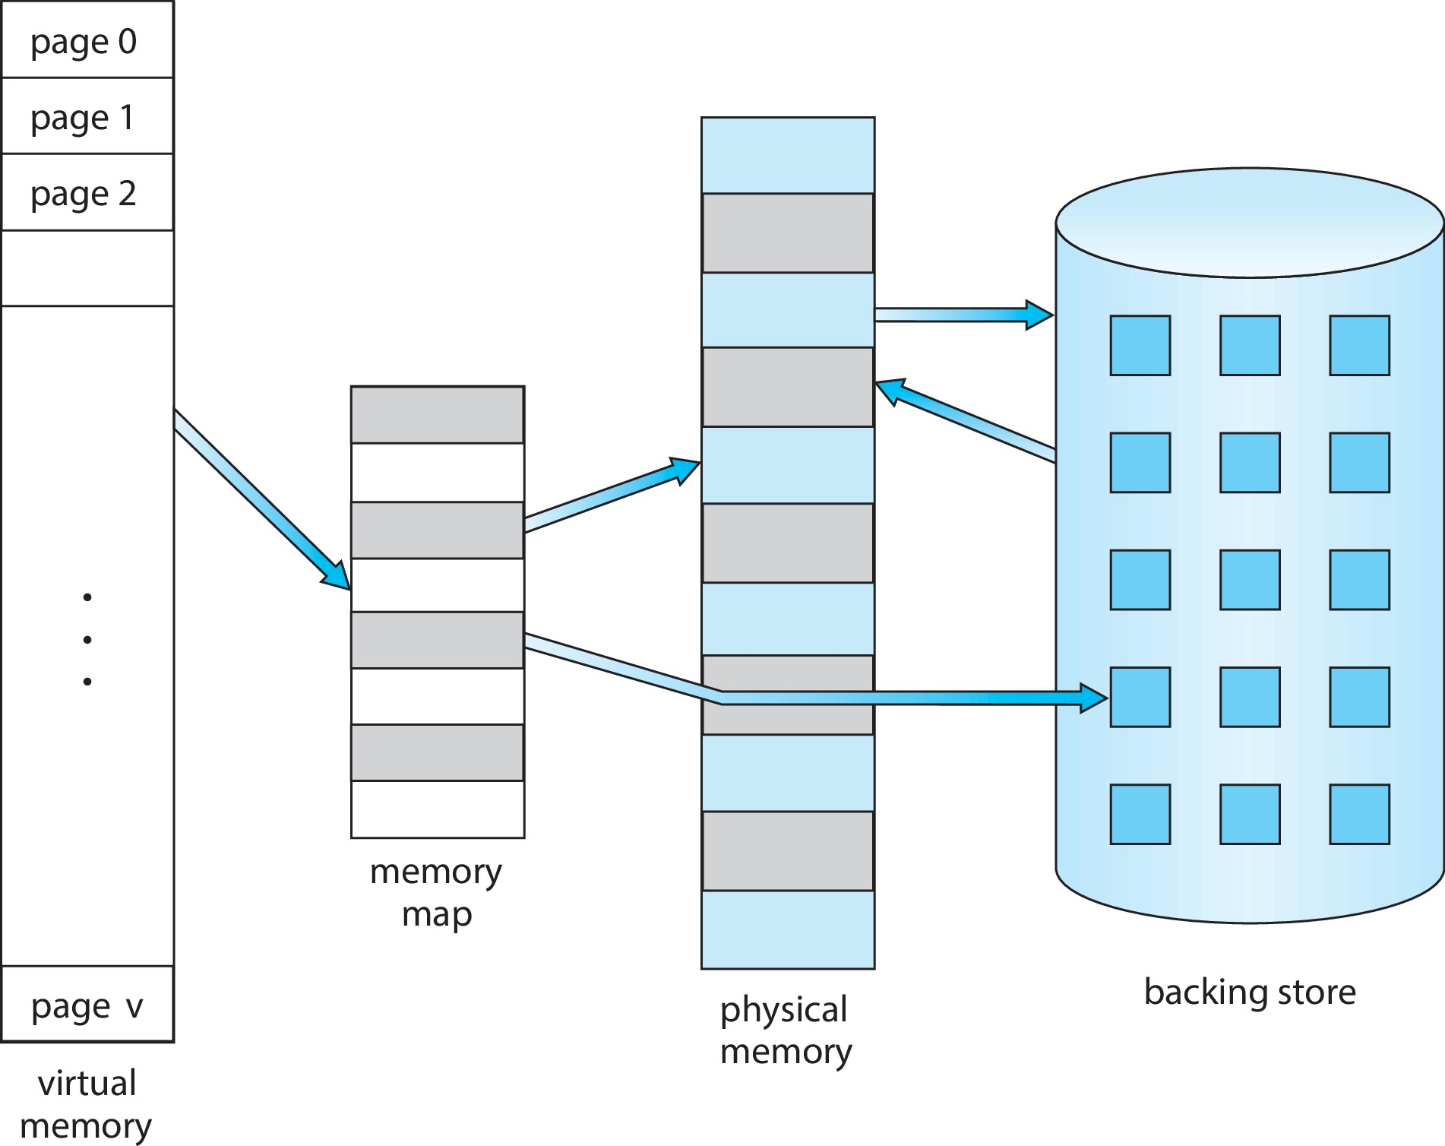
Virtual Memory That is Larger Than Physical Memory (Self Study)

Slide 37
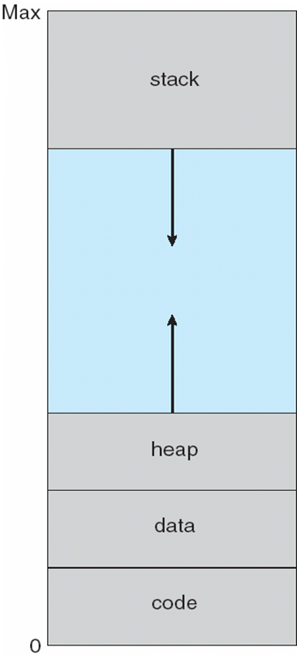
Virtual-address Space (Self Study)
Usually design logical address space for stack to start at Max logical address and grow “down” while heap grows “up”
Maximizes address space use
Unused address space between the two is hole
No physical memory needed until heap or stack grows to a given new page
Enables sparse address spaces with holes left for growth, dynamically linked libraries, etc.
System libraries shared via mapping into virtual address space
Shared memory by mapping pages read-write into virtual address space
Pages can be shared during fork(), speeding process creation

Slide 38
Demand Paging
Could bring entire process into memory at load time
Or bring a page into memory only when it is needed
Less I/O needed, no unnecessary I/O
Less memory needed
Faster response
More users
Similar to paging system with swapping (diagram on right)
Page is needed ⇒ reference to it
invalid reference ⇒ abort
not-in-memory ⇒ bring to memory
Lazy swapper – never swaps a page into memory unless page will be needed
Swapper that deals with pages is a pager

Slide 39
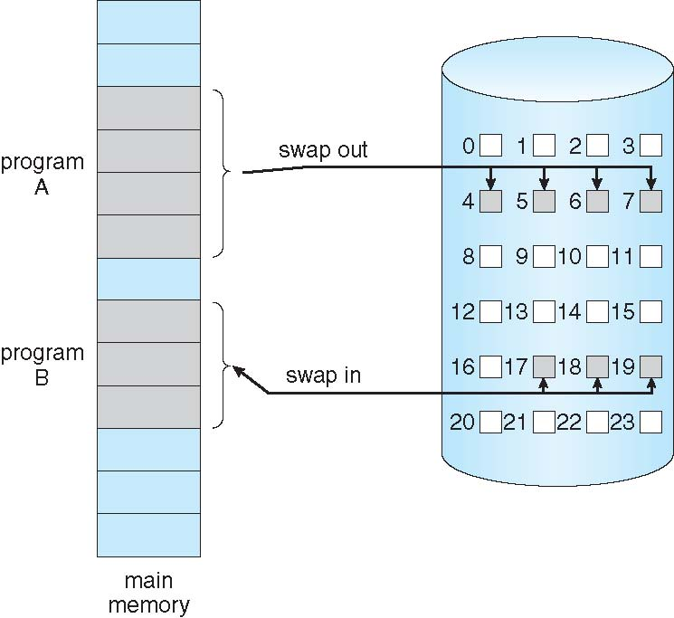
Demand Paging
Could bring entire process into memory at load time
Or bring a page into memory only when it is needed
Less I/O needed, no unnecessary I/O
Less memory needed
Faster response
More users
Similar to paging system with swapping (diagram on right)

Slide 40
Basic Concepts (Self Study)
With swapping, pager guesses which pages will be used before swapping out again
Instead, pager brings in only those pages into memory
How to determine that set of pages?
Need new MMU functionality to implement demand paging
If pages needed are already memory resident
No difference from non demand-paging
If page needed and not memory resident
Need to detect and load the page into memory from storage
Without changing program behavior
Without programmer needing to change code

Slide 41
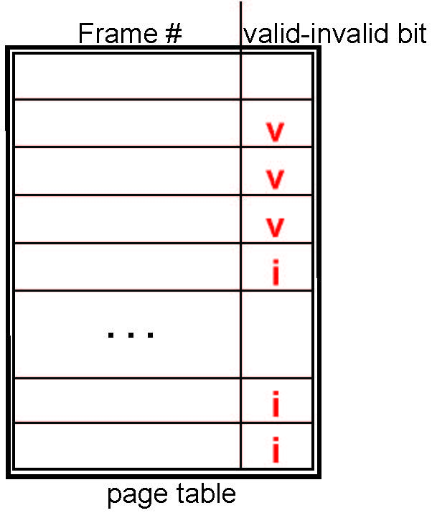
Valid-Invalid Bit
With each page table entry a valid–invalid bit is associated (v ⇒ in-memory – memory resident, i ⇒ not-in-memory)
Initially valid–invalid bit is set to i on all entries
Example of a page table snapshot:
During MMU address translation, if valid–invalid bit in page table entry is i ⇒ page fault

Slide 42
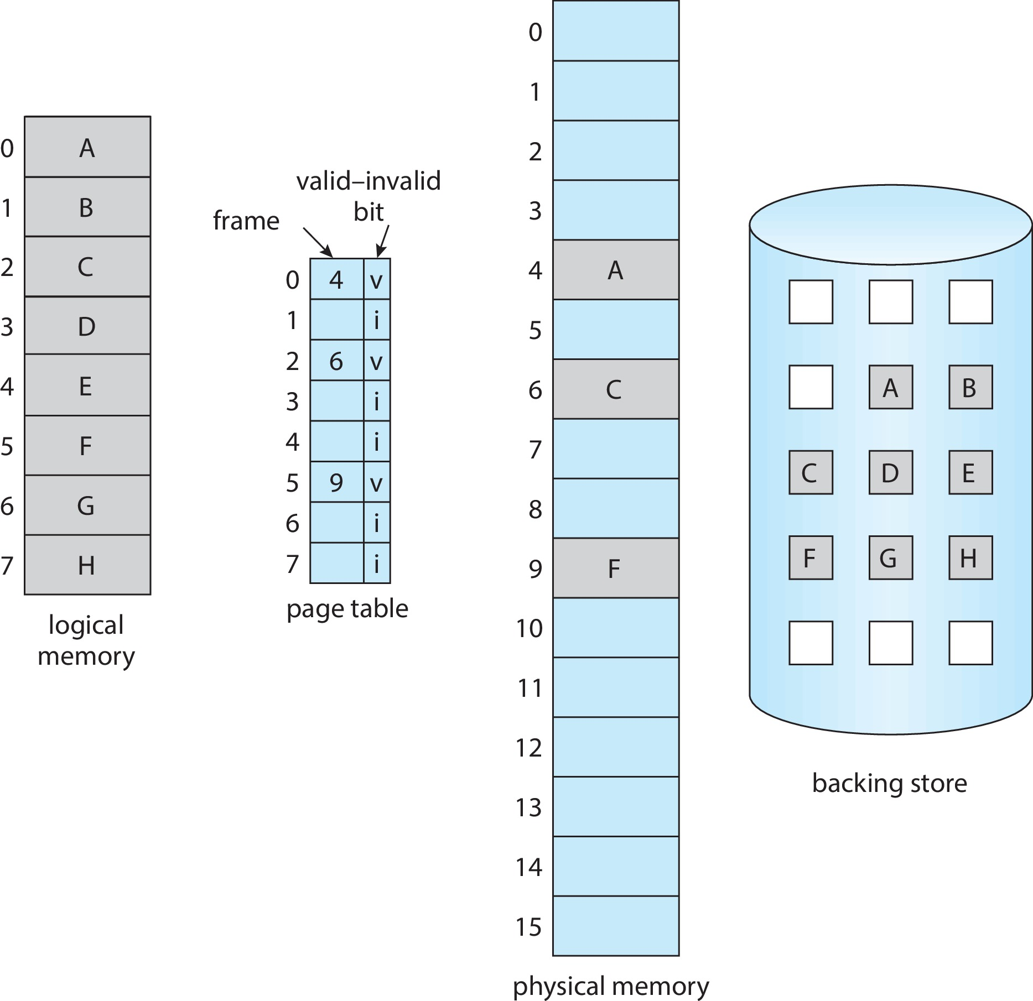
Page Table When Some Pages Are Not in Main Memory

Slide 43
Steps in Handling Page Fault (Self Study)
If there is a reference to a page, first reference to that page will trap to operating system
Page fault
Operating system looks at another table to decide:
Invalid reference ⇒ abort
Just not in memory
Find free frame
Swap page into frame via scheduled disk operation
Reset tables to indicate page now in memory Set validation bit = v
Restart the instruction that caused the page fault

Slide 44

Steps in Handling a Page Fault (Cont.) (Self Study)

Slide 45
Aspects of Demand Paging (Self Study)
Extreme case – start process with no pages in memory
OS sets instruction pointer to first instruction of process, non-memory-resident -> page fault
And for every other process pages on first access
Pure demand paging
Actually, a given instruction could access multiple pages -> multiple page faults
Consider fetch and decode of instruction which adds 2 numbers from memory and stores result back to memory
Pain decreased because of locality of reference
Hardware support needed for demand paging
Page table with valid / invalid bit
Secondary memory (swap device with swap space)
Instruction restart

Slide 46
Stages in Demand Paging – Worse Case (Self Study)
Trap to the operating system
Save the user registers and process state
Determine that the interrupt was a page fault
Check that the page reference was legal and determine the location of the page on the disk
Issue a read from the disk to a free frame:
Wait in a queue for this device until the read request is serviced
Wait for the device seek and/or latency time
Begin the transfer of the page to a free frame

Slide 47
Stages in Demand Paging (Cont.) (Self Study)
While waiting, allocate the CPU to some other user
Receive an interrupt from the disk I/O subsystem (I/O completed)
Save the registers and process state for the other user
Determine that the interrupt was from the disk
Correct the page table and other tables to show page is now in memory
Wait for the CPU to be allocated to this process again
Restore the user registers, process state, and new page table, and then
resume the interrupted instruction

Slide 48
Performance of Demand Paging (Self Study)
Three major activities
Service the interrupt – careful coding means just several hundred instructions needed
Read the page – lots of time
Restart the process – again just a small amount of time
Page Fault Rate 0 ≤ p ≤ 1
if p = 0 no page faults
if p = 1, every reference is a fault
Effective Access Time (EAT)
EAT = (1 – p) x memory access
+ p (page fault overhead
+ swap page out
+ swap page in )

Slide 49
Demand Paging Example (Self Study)
Memory access time = 200 nanoseconds
Average page-fault service time = 8 milliseconds
EAT = (1 – p) x 200 + p (8 milliseconds)
= (1 – p x 200 + p x 8,000,000
= 200 + p x 7,999,800
If one access out of 1,000 causes a page fault, then
EAT = 8.2 microseconds.
This is a slowdown by a factor of 40!!
If want performance degradation < 10 percent
220 > 200 + 7,999,800 x p 20 > 7,999,800 x p
p < .0000025
< one page fault in every 400,000 memory accesses

Slide 50
Copy-on-Write
Copy-on-Write (COW) allows both parent and child processes to initially share the same pages in memory
If either process modifies a shared page, only then is the page copied
COW allows more efficient process creation as only modified pages are copied
In general, free pages are allocated from a pool of zero-fill-on-demand pages
Pool should always have free frames for fast demand page execution
Don’t want to have to free a frame as well as other processing on page fault
Why zero-out a page before allocating it?
vfork() variation on fork() system call has parent suspend and child using copy-on-write address space of parent
Designed to have child call exec()
Very efficient

Slide 51
Page Replacement (Self Study)
Prevent over-allocation of memory by modifying page-fault service routine to include page replacement
Use modify (dirty) bit to reduce overhead of page transfers – only modified pages are written to disk
Page replacement completes separation between logical memory and physical memory – large virtual memory can be provided on a smaller physical memory

Slide 52
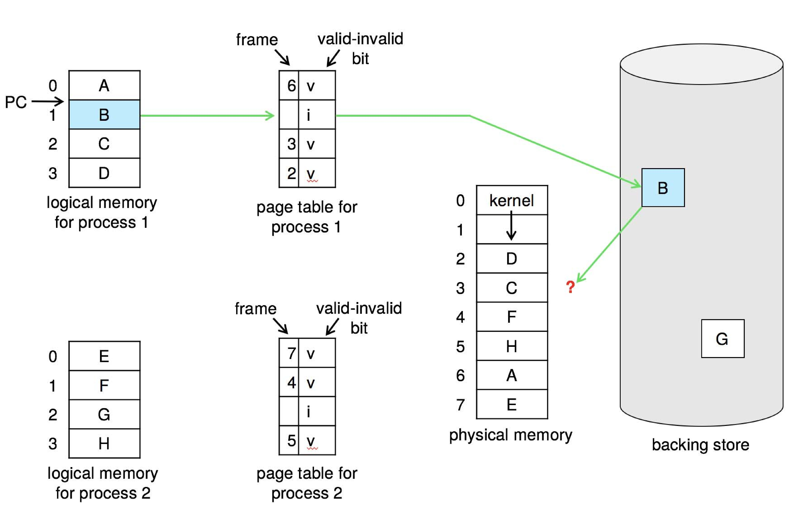
Need For Page Replacement (Self Study)

Slide 53
Basic Page Replacement
Find the location of the desired page on disk
Find a free frame: - If there is a free frame, use it - If there is no free frame, use a page replacement algorithm to select a victim frame - Write victim frame to disk if dirty
Bring the desired page into the (newly) free frame; update the page and frame tables
Continue the process by restarting the instruction that caused the trap
Note now potentially 2 page transfers for page fault – increasing EAT

Slide 54
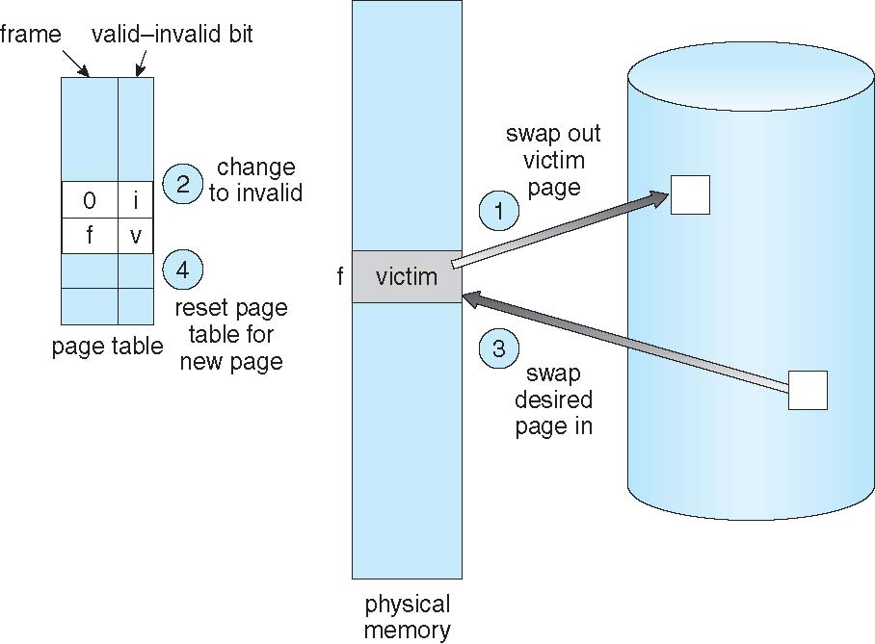
Page Replacement (Self Study)

Slide 55
Page and Frame Replacement Algorithms
Frame-allocation algorithm determines
How many frames to give each process
Which frames to replace
Page-replacement algorithm
Want lowest page-fault rate on both first access and re-access
Evaluate algorithm by running it on a particular string of memory references (reference string) and computing the number of page faults on that string
String is just page numbers, not full addresses
Repeated access to the same page does not cause a page fault
Results depend on number of frames available
In all our examples, the reference string of referenced page numbers is
7,0,1,2,0,3,0,4,2,3,0,3,0,3,2,1,2,0,1,7,0,1

Slide 56
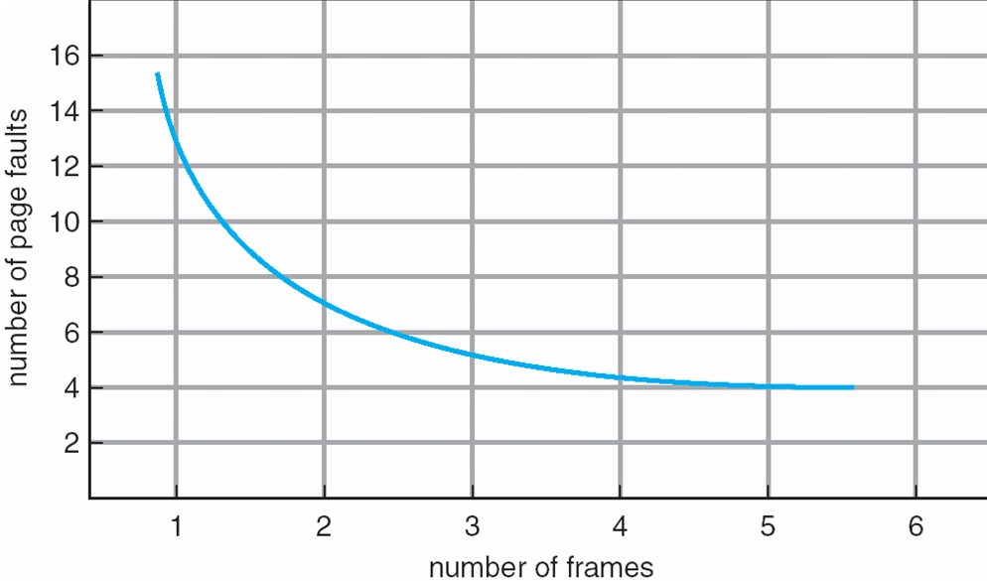
Graph of Page Faults Versus the Number of Frames

Slide 57
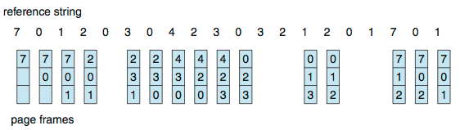
First-In-First-Out (FIFO) Algorithm
Reference string: 7,0,1,2,0,3,0,4,2,3,0,3,0,3,2,1,2,0,1,7,0,1
3 frames (3 pages can be in memory at a time per process)
Can vary by reference string: consider 1,2,3,4,1,2,5,1,2,3,4,5
Adding more frames can cause more page faults!
Belady’s Anomaly
How to track ages of pages?
Just use a FIFO queue
15 page faults

Slide 58
FIFO Illustrating Belady’s Anomaly

Slide 59
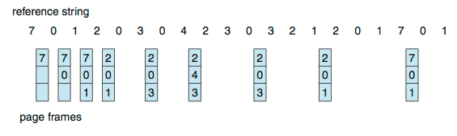
Optimal Algorithm
Replace page that will not be used for longest period of time
9 is optimal for the example
How do you know this?
Can’t read the future
Used for measuring how well your algorithm performs

Slide 60
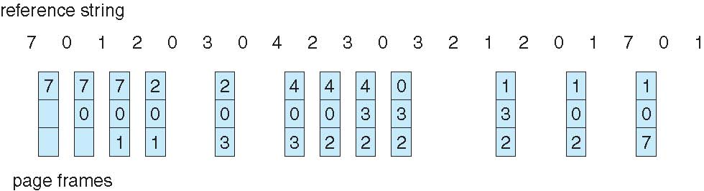
Least Recently Used (LRU) Algorithm
Use past knowledge rather than future
Replace page that has not been used in the most amount of time
Associate time of last use with each page
12 faults – better than FIFO but worse than OPT
Generally good algorithm and frequently used
But how to implement?

Slide 61
LRU Algorithm (Cont.)
Counter implementation
Every page entry has a counter; every time page is referenced through this entry, copy the clock into the counter
When a page needs to be changed, look at the counters to find smallest value
Search through table needed
Stack implementation
Keep a stack of page numbers in a double link form:
Page referenced:
move it to the top
requires 6 pointers to be changed
But each update more expensive
No search for replacement

Slide 62
LRU Algorithm (Cont.)
LRU and OPT are cases of stack algorithms that don’t have Belady’s Anomaly
Use Of A Stack to Record Most Recent Page References

Slide 63
Thrashing
If a process does not have “enough” pages, the page-fault rate is very high
Page fault to get page
Replace existing frame
But quickly need replaced frame back
This leads to:
Low CPU utilization
Operating system thinking that it needs to increase the degree of multiprogramming
Another process added to the system

Slide 64
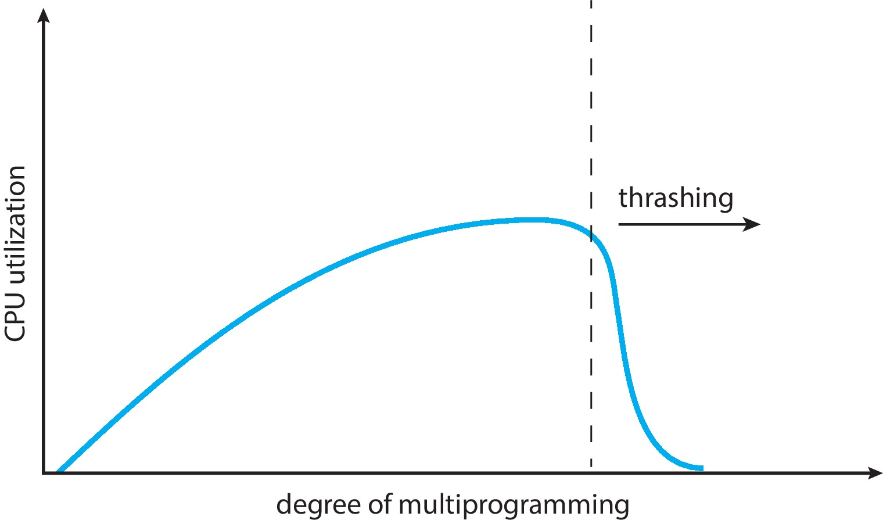
Thrashing (Cont.)
Thrashing. A process is busy swapping pages in and out

